Slide 1

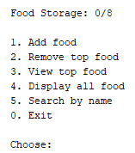
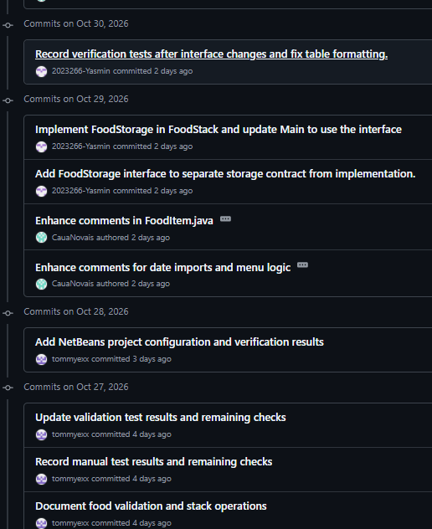
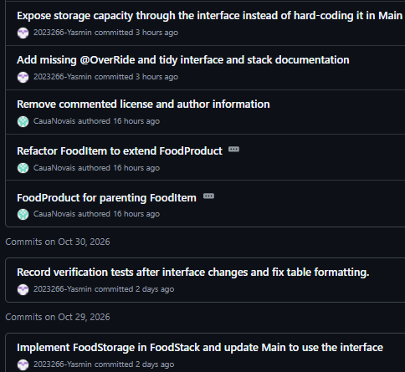
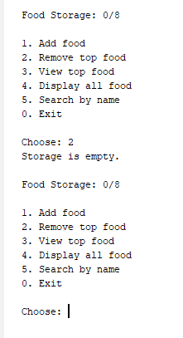


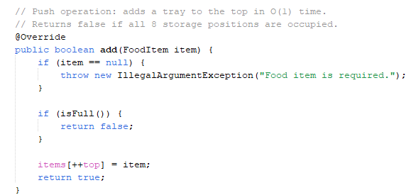
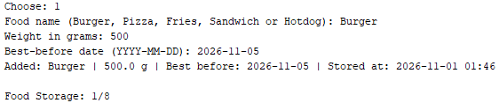

CA1 - Algorithms & Constructs: Fast Food Storage Java Application
Students: Caua Novais da Silva - 2023164
Tilek Ulan Uulu - 2023193
Yasmin Luize Nogueira Moura - 2023266
Useful links:
GitHub repository: https://github.com/CauaNovais/algorithms-constructs-ca1.git
Lecturer: Taufique Ahmed
Video link: https://www.youtube.com/watch?v=9zCswQbkKTE
PROJECT OVERVIEW
JAVA APPLICATION
TESTING & ERROR HANDLING
COMMITS AND CONTRIBUTIONS:
The Food Storage Management System is a Java console application that manages up to eight food trays. Each item records its name, weight, best-before date (maximum 14 days) and storage time. Users can add, remove, view the top item, display all items and search by name.
The main class displays a menu with options from 0 to 5: add, remove, view top, display all, search and exit.
Error handling was implemented for invalid inputs and empty storage. The examples below show how the application responds:
WHY A STACK (LIFO)
The storage operations are defined by the FoodStorage interface and implemented in the FoodStack class. The add method is shown below:
According to Amaylia et al. (2025), in a stack the last item added is the first item removed (LIFO), using the push and pop operations, implemented as add and remove in our code. In this scenario, the chef can use the front side both to add and to remove trays, so a single opening naturally produces LIFO behaviour. A fixed-size array matches the eight positions, and push, pop and peek run in O(1) time. A queue would require access from both sides.
When successfully added, the item will be displayed in a way the user will understand it was successfully added.
Tilek (tommyexx): initial implementation, including the FoodItem model with validation, the array-based stack with LIFO operations, display and search, the console menu and the first manual tests.
Caua (CauaNovais): repository setup, FoodProduct parent class with FoodItem inheritance, code comments and the initial poster draft.
Yasmin (2023266-Yasmin): FoodStorage interface, capacity method, abstract FoodProduct, output formatting, final testing, README and the final poster.
add (push)
remove (pop)
TIME COMPLEXITY
STORAGE CAPACITY
The storage holds a maximum of 8 items, controlled by a fixed-size array in the FoodStack class. When it is full, new items are rejected until one is removed.
n is the number of trays currently stored.
top
Operation | Time | Reason
add (push) | O(1) | Places the tray at the next top index
remove (pop) | O(1) | Accesses only the top position
peek | O(1) | Returns the top without changes
display | O(n) | Visits every stored tray
search | O(1) best, O(n) worst | Found at the top, or at the bottom or absent
Pizza
Fries
Burger
Array-based stack with eight positions.
Trays are added and removed only at the top.
LIMITATIONS
ADVANTAGES OF USING LIFO
Older trays stay at the bottom and may expire; the 14-day limit reduces this risk.
Search may need to check every position, O(n).
Capacity and food names are fixed in the code.
Simple management: Items are easy to add and remove.
Fast operations: Adding and removing items take O(1) time.
Controlled storage: The fixed-size array prevents the system from exceeding its capacity of eight items.
Space complexity: O(n), bounded by the fixed capacity of 8.
REFERENCES
Amaylia, S., Setiabud, V.A., Renza Alvianino, Saputra, R.N., Kusuma Wardhani, H. and Azis Suroni (2025). Application of stack data structure in application development. Journal of Advanced Systems Intelligence and Cybersecurity, [online] 1(01). Available at: https://journal.unesa.ac.id/index.php/jasic/article/view/44459? (Accessed: 29 October 2026)

